Slide 1
CSC 112: Computer Operating Systems Lecture XX TODO
Department of Computer Science,
Hofstra University
Acknowledgement: Lecture slides based on UC Berkeley CS 162: Operating Systems and System Programming

Slide 2








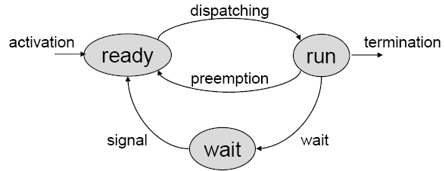
Resource Sharing
Some shared resources do not allow simultaneous accesses but require mutual exclusion. A piece of code executed under mutual exclusion constraints is called a critical section.
When two tasks access shared resource, semaphores are used to protect critical sections.
Each shared resource R_{i} must be protected by a semaphore S_{i}, and each critical section (CS) using resource R_{i} must begin with wait(S_{i}) and end with signal(S_{i})
A task waiting for an exclusive resource is said to be blocked on that resource. Otherwise, it proceeds by entering the critical section and holds the resource. When a task leaves a critical section, the associated resource becomes free.
Tasks blocked on the same resource are kept in a queue. When a running task invokes wait(S_{i}) when S_{i} is locked, it enters a waiting state, until another task invokes signal(S_{i}) to unlock S_{i}
globlal memory buffer
wait(s)
x = 3;
y = 5;
signal(s)
wait(s)
a = x+1;
b = y+2;
c = x+y;
signal(s)
write
int x;
int y;
read
Notes:
Examples of common resources: data structures, variables, main memory area, file, set of registers, I/O unit, … . Examples of common resources: data structures, variables, main memory area, file, set of registers, I/O unit, … .
Many shared resources do not allow simultaneous accesses but require mutual exclusion (exclusive resources). A piece of code executed under mutual exclusion constraints is called a critical section.
A task waiting for an exclusive resource is said to be blocked on that resource. Otherwise, it proceeds by entering the critical section and holds the resource. When a task leaves a critical section, the associated resource becomes free.
Waiting state caused by resource constraints:

Slide 3







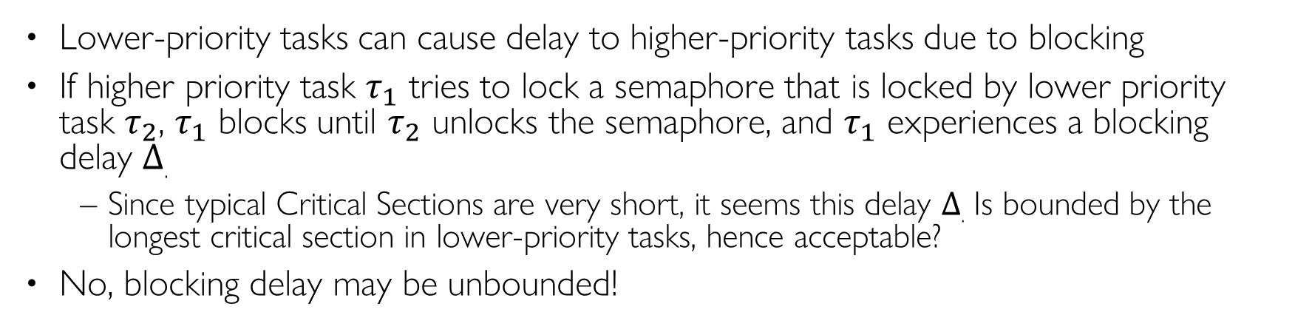
Blocking Delay
Lower-priority tasks can cause delay to higher-priority tasks due to blocking
If higher priority task $τ_{1}$ tries to lock a semaphore that is locked by lower priority task $τ_{2}$, $τ_{1}$ blocks until $τ_{2}$ unlocks the semaphore, and $τ_{1}$ experiences a blocking delay $Δ$.
Since typical Critical Sections are very short, it seems this delay $Δ$. Is bounded by the longest critical section in lower-priority tasks, hence acceptable?
No, blocking delay may be unbounded!
τ₁
τ₂
Δ
τ₁
τ₂
CS
CS
Notes:
It seems that the maximum blocking time for τ1 is equal to the length of the critical section of τ2, but …

Slide 4
Example Taskset
Task | T | D | C | Prio
A | 50 | 10 | 5 | H
B | 500 | 500 | 250 | M
C | 3000 | 3000 | 1000 | L
Utilization=5/50+250/500+1000/3000=0.93
WCRT (without blocking delays):
R_{A}=5, R_{B}=280, R_{C}=2500

Slide 5
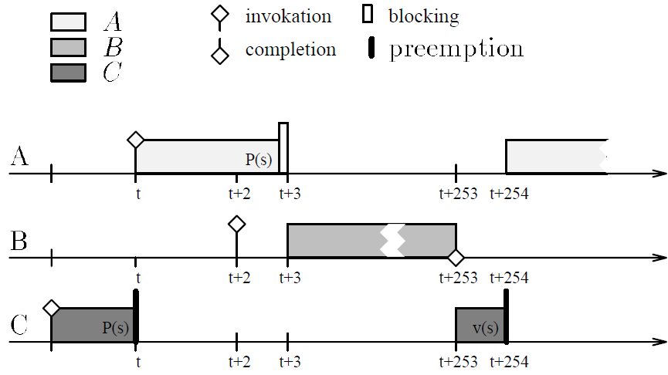
Priority Inversion
Task | T | D | C | Prio
A | 50 | 10 | 5 | H
B | 500 | 500 | 250 | M
C | 3000 | 3000 | 1000 | L
HP: High-Priority; MP: Medium-Priority; LP: Low-Priority
t: LP C locks s
t+∆: HP task A preempts LP task C
t+2: MP task B is invoked, but cannot start running due to HP task A running
t+3: HP task A tries to lock s, blocks since LP task C is holding s; MP task B starts running
t+253: MP task B finishes; LP task C starts running
t+254: LP task C unlocks s; HP last A starts running, but it already missed its deadline long ago!

Slide 6
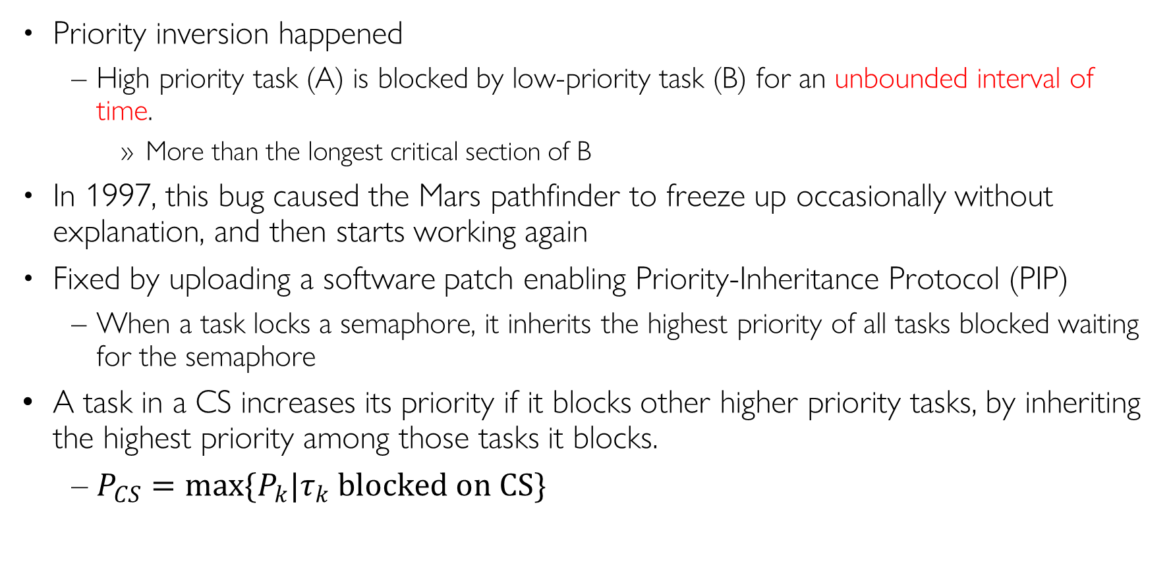
Priority Inversion and Priority Inheritance
Priority inversion happened
High priority task (A) is blocked by low-priority task (B) for an unbounded interval of time.
More than the longest critical section of B
In 1997, this bug caused the Mars pathfinder to freeze up occasionally without explanation, and then starts working again
Fixed by uploading a software patch enabling Priority-Inheritance Protocol (PIP)
When a task locks a semaphore, it inherits the highest priority of all tasks blocked waiting for the semaphore
A task in a CS increases its priority if it blocks other higher priority tasks, by inheriting the highest priority among those tasks it blocks.
$P_{CS}=\max{\{P_{k}|τ_{k} blocked on CS\}}$

Slide 7
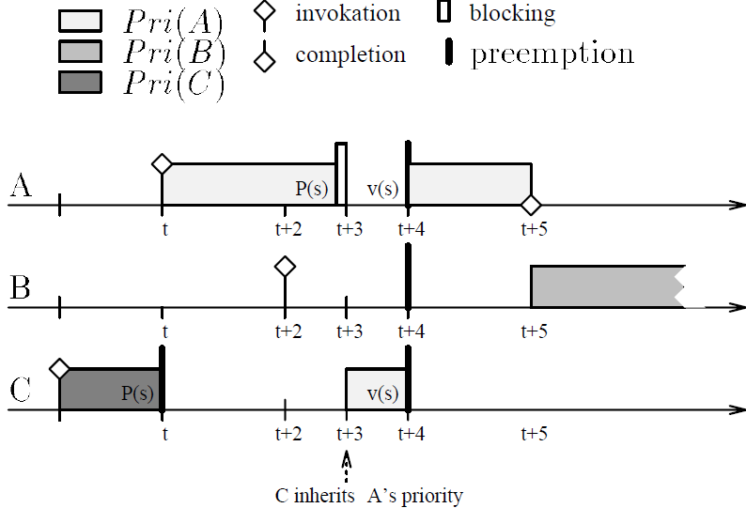
With PIP
Task | T | D | C | Prio
A | 50 | 10 | 5 | H
B | 500 | 500 | 250 | M
C | 3000 | 3000 | 1000 | L
t: LP C locks s
t+∆: HP task A preempts LP task C
t+2: MP task B is invoked, but cannot start running due to HP task A running
t+3: HP task A tries to lock s, blocks since LP task C is holding s; C inherits A’s priority and starts running
MP task B cannot start running, hence cannot cause unbounded blocking to HP task A
t+4: LP task C unlocks s, and returns to its regular Low priority; HP task A locks s and starts running
t+5: HP task A finishes and meets its deadline.

Slide 8
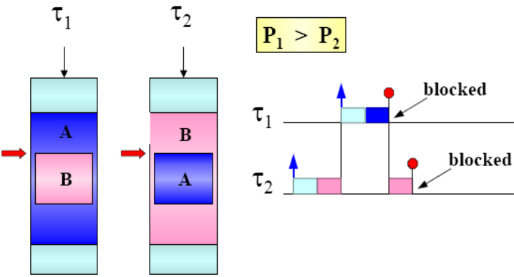
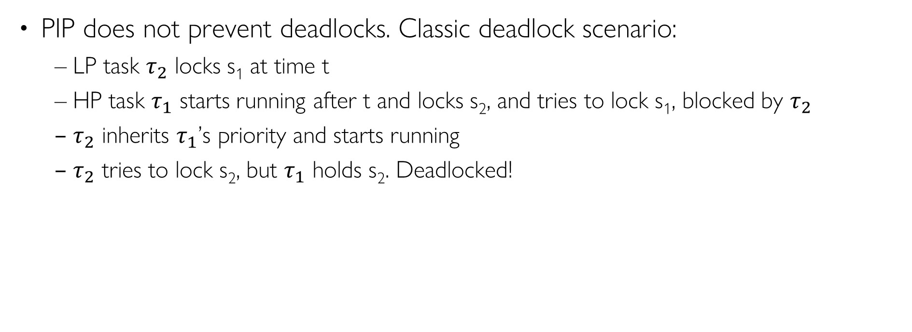
PIP Properties
PIP does not prevent deadlocks. Classic deadlock scenario:
LP task $τ_{2}$ locks s₁ at time t
HP task $τ_{1}$ starts running after t and locks s₂, and tries to lock s₁, blocked by $τ_{2}$
$τ_{2}$ inherits $τ_{1}$’s priority and starts running
$τ_{2}$ tries to lock s₂, but $τ_{1}$ holds s₂. Deadlocked!

Slide 9

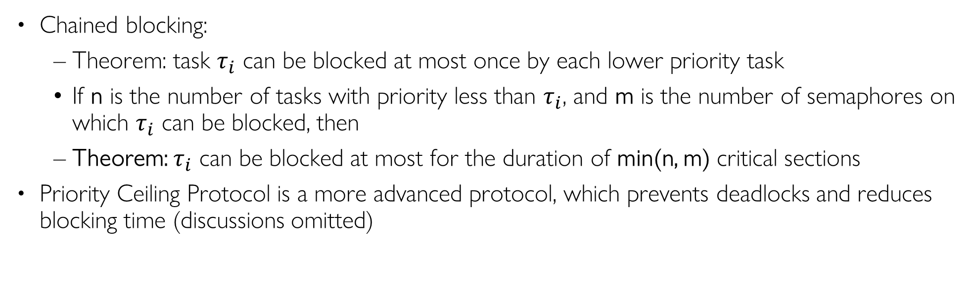
PIP Properties
Chained blocking:
Theorem: task $τ_{i}$ can be blocked at most once by each lower priority task
If n is the number of tasks with priority less than $τ_{i}$, and m is the number of semaphores on which $τ_{i}$ can be blocked, then
Theorem: $τ_{i}$ can be blocked at most for the duration of min(n, m) critical sections
Priority Ceiling Protocol is a more advanced protocol, which prevents deadlocks and reduces blocking time (discussions omitted)
priority
τ₁
B₁ B₂ B₃
τ₂
τ₃
τ₄

